Slide 1
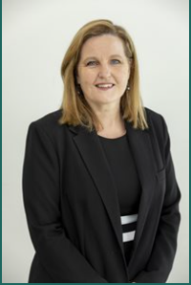
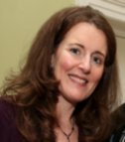
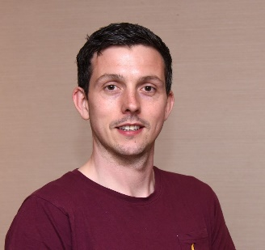
Educate, Innovate,
Celebrate, Collaborate
SAVE THE DATE
Cork University Hospital Nursing Conference
Tuesday 27th February 2024
Keynote Speakers
Dr Karen Weekes, Performance Psychologist / Endurance Adventurer
Methods of coping within high pressure environments
Ms Carolyn Donohoe NMBI’s Director of Education, Policy and Standards
Where will education lead us, 2024 and beyond…
Ms Marie Kilduff, Director of National Clinical Leadership Centre (NCLC) for Nursing and Midwifery, ONMSD, HSE
Leadership, it starts with you
Ms Vera Keohane, Professional Organiser
Declutter to Delight – elevating your mental health through order
Mr. Dermot Burke, National Innovation Fellow with the HSE Spark Innovation Programme & Product Manager at Cushla Health
AI + ML in Healthcare: Basic concepts, possibilities and supports available
Details on how to register for the Conference will follow at a later date

